Slide 1

RENTAL MANAGEMENT SYSTEM
PROJECT BY:-
Pranav Malkar
Ankita Kenjale
Dishank Mahajan
Trupti Ingle
GUIDANCE BY:-
Mrs. Yogita Wankhede

Slide 2
ABSTRACT
Web-based Rental Management System
Automates property rental operations
Allows owners to list properties and customers to search, book, and pay online
Replaces traditional manual rental processes
Provides role-based access for Admin, Owners, and Customers
Improves efficiency, security, transparency, and user experience

Slide 3

INTRODUCTION
Designed to simplify property renting and booking activities
Supports secure user registration and login
Provides role-based access to system features
Enables owners to add, update, and manage properties
Allows customers to search, view details, and book properties
Stores property details like location, price, availability, images, and amenities

Slide 4
PROBLEM STATEMENT
Traditional rental systems depend on manual processes
Paperwork and offline bookings are time-consuming
Customers face difficulty in finding properties and making secure payments
Property owners struggle to manage bookings and availability
Manual systems increase the risk of data loss and booking conflicts
Lack of transparency leads to poor customer experience

Slide 5
OBJECTIVES
To develop an online platform for property rental management
To allow property owners to list and manage rental properties
To enable customers to search, view, and book properties easily
To provide secure user authentication and role-based access
To integrate online payment for confirmed bookings
To improve efficiency, accuracy, and transparency in rental operations

Slide 6

SCOPE OF PROJECT
User registration and login system
Role-based access for Admin, Owner, and Customer
Property listing with images, price, and location
Property availability and booking management
Secure online payment processing
Booking history and property management dashboards
Can be extended with reviews, ratings, and mobile app support

Slide 7
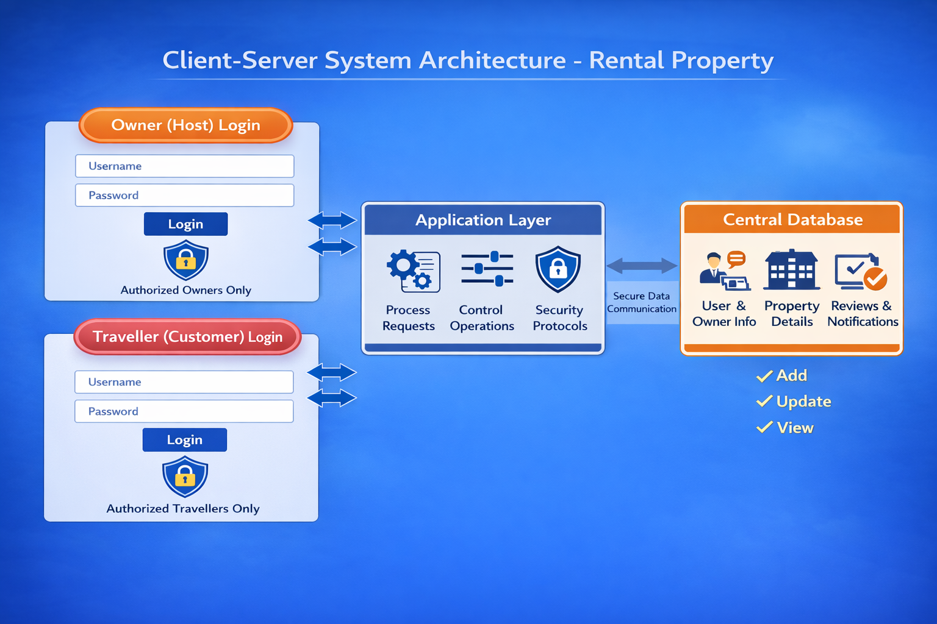

Slide 8
WORKFLOW OF PROJECT
User accesses the Rental Management System
User registers or logs in using valid credentials
System authenticates user and identifies role
Dashboard is displayed based on user role
Owner adds or manages property listings
Customer searches and views property details
Customer selects property and confirms booking
Online payment is processed
Booking details are stored in the database
User can view booking history and property status and can write review about property

Slide 9
PROJECT MODULES
Admin Module
- Manages users, properties, and bookings
- Controls system access and monitors activities
- Can view all rental data and reports
Owner (Host) Module
- Registers and logs in securely
- Adds, updates, and deletes property listings
- Uploads property and room images
- Views bookings related to own properties
Customer (Guest) Module
- Registers and logs in securely
- Searches properties by location and price
- Views detailed property descriptions and images
- Books properties and makes online payments
- Views booking history

Slide 10
Property Listing Module
- Allows property owners to list rental properties
- Stores property details such as location, price, and amenities
- Manages property availability status
- Displays listed properties to customers
- Provides detailed property information
Booking & Payment Module
- Handles property availability
- Confirms bookings
- Integrates online payment gateway
- Stores transaction details securely
Review and Notifications
- Allows users to submit reviews for properties
- Sends real-time notifications to property owners
- Manages review data securely

Slide 11
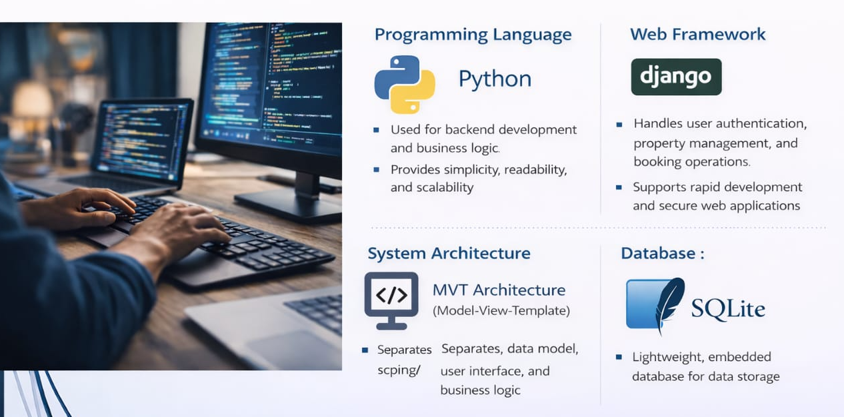
TECHNOLOGIES AND FRAMEWORK

Slide 12
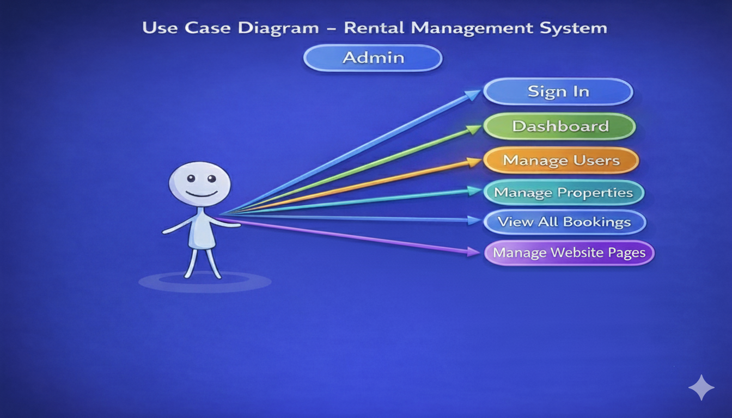

Slide 13
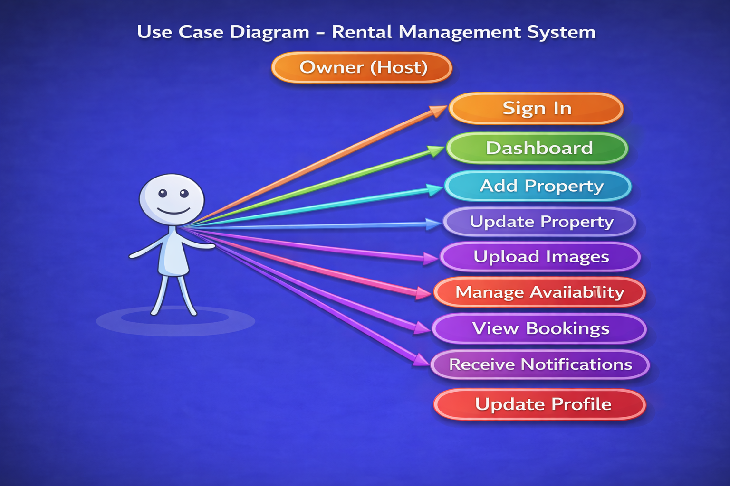

Slide 14
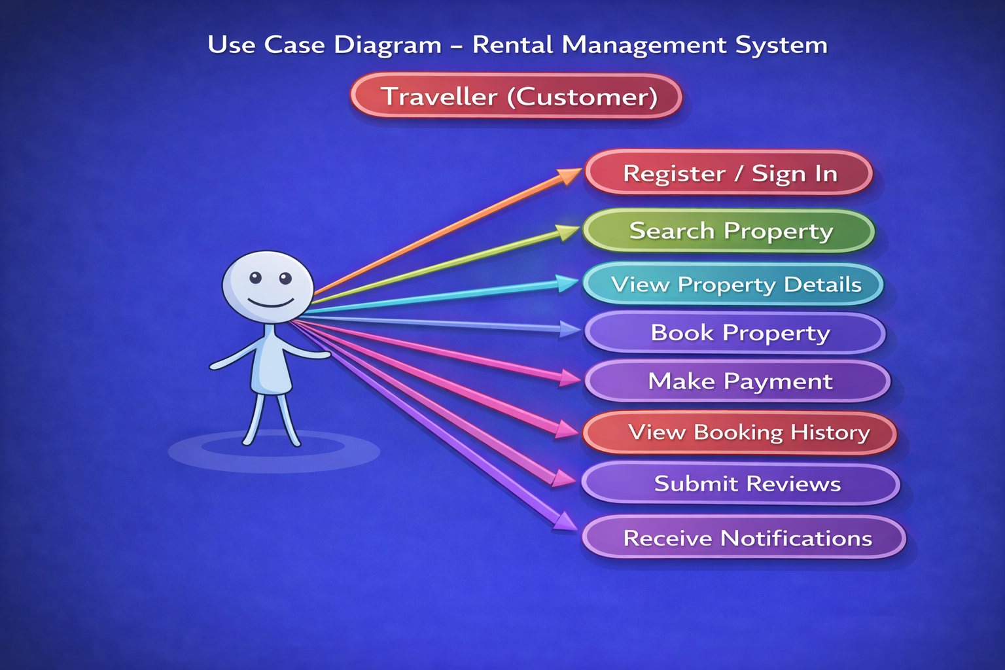

Slide 15
ADVANTAGES
Reduces manual paperwork and offline booking
Provides easy property search and booking
Secure login and payment system
Improves communication between owners and customers
Prevents booking conflicts
User-friendly and scalable system

Slide 16
APPLICATION
Online property rental platforms
Hotel and homestay booking systems
Apartment and villa rental services
Travel and tourism industry
Real estate rental management

Slide 17
CONCLUSION
The Rental Management System is a complete web-based solution for managing property rentals efficiently. It automates property listing, booking, and payment processes while ensuring data security and user convenience. The system reduces manual effort, improves customer satisfaction, and provides a scalable platform for rental businesses. It successfully bridges the gap between property owners and customers through a secure and user-friendly digital solution.

Slide 18
THANK YOU…

